Slide 1


Trend Analysis
Yonas M. Gebrewubet (CPIU, Hydrologist, SINOTECH)
JULy 07, 2023

Slide 2
OUTLIERS - OUTLIER DETECTION
Plot the time series data to visually inspect for outliers.
Use statistical methods to detect outliers, such as the Z-score or the Interquartile Range (IQR) method.

Slide 3
Extreme value analysis vs outlier analysis
The most basic form of outlier detection is extreme-value analysis of 1-dimensional data. These are very specific types of outliers in which it is assumed that the values that are either too large or too small are outliers. Such special kinds of outliers are also important in many application-specific scenarios.
Confusions between extreme-value analysis and outlier analysis are common, especially in the context of multivariate data. This is quite often the case, since many extreme-value models also use probabilistic models in order to quantify the probability that a data point is an extreme value.

Slide 4
OUTLIERS - STATISTICAL METHODS
Statistical Methods:
Z-score: Calculate the z-score for each data point by subtracting the mean and dividing by the standard deviation of the series. Data points with a z-score above a certain threshold (e.g., 3) are considered outliers.
Modified z-score: Similar to the z-score, but it uses the median and median absolute deviation instead of the mean and standard deviation. This method is more robust to outliers.
Grubbs' test: Based on the principle of hypothesis testing, Grubbs' test identifies the maximum or minimum value that significantly deviates from the mean of the series.

Slide 5
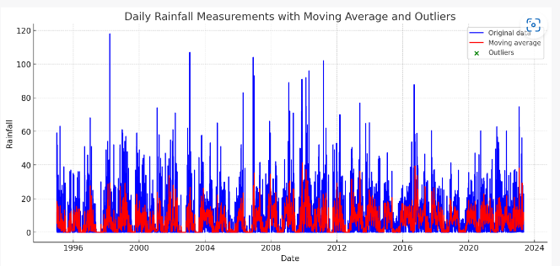
OUTLIERS - MOVING AVERAGE BASED METHODS
Moving Average-Based Methods:
Moving Average: Compute a moving average of the series over a sliding window. Data points that differ significantly from the moving average can be considered outliers.
Exponential Smoothing: Apply exponential smoothing techniques to capture the trend and seasonality in the time series. Outliers can be identified as observations that deviate significantly from the smoothed values.

Slide 6
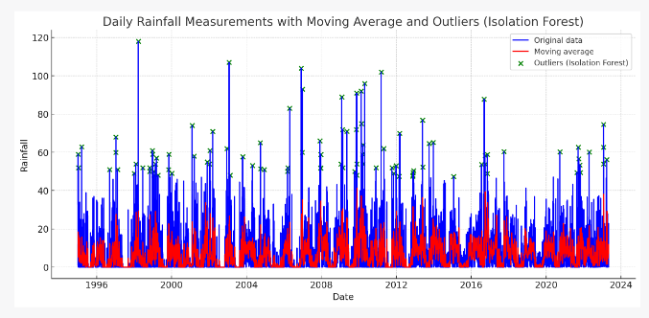
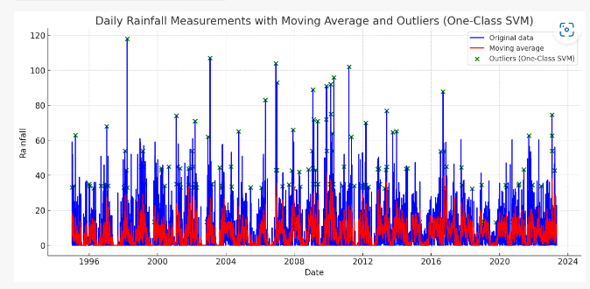
OUTLIERS - MACHINE LEARNING BASED METHODS
Machine Learning-Based Methods:
Support Vector Machines (SVM): SVM can be trained to classify normal and outlier patterns in time series data. Outliers are identified based on their deviation from the decision boundary.
Isolation Forest: This algorithm constructs an ensemble of isolation trees to isolate outliers. Data points that require fewer splits to isolate are considered outliers.
Autoencoders: Deep learning models like autoencoders can be trained to reconstruct time series data. Outliers are identified as data points that have high reconstruction errors.
99 outliers
197 outliers

Slide 7
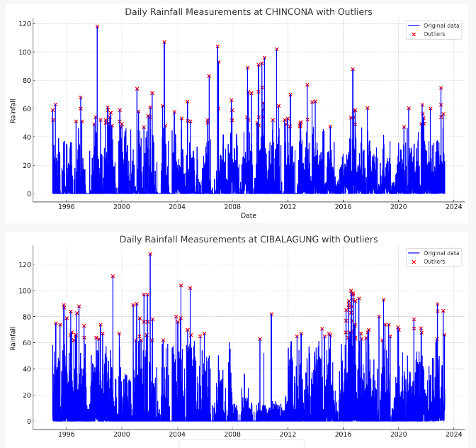
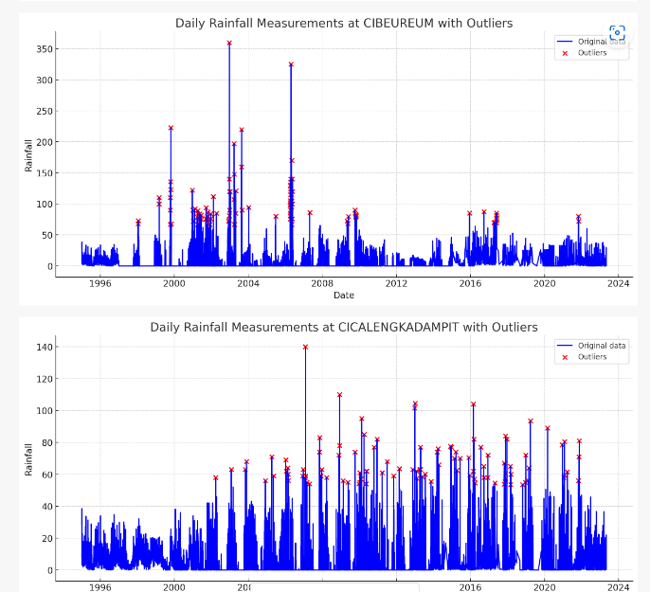
OUTLIERS - Isolation Forest

Slide 8
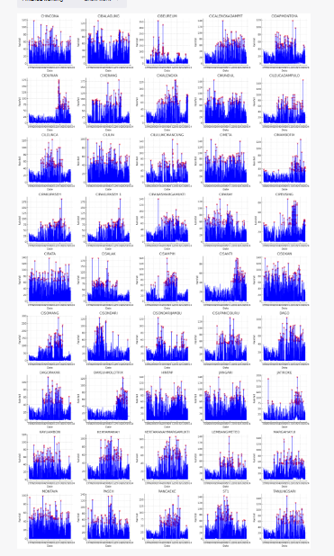
OUTLIERS - Isolation Forest

Slide 9
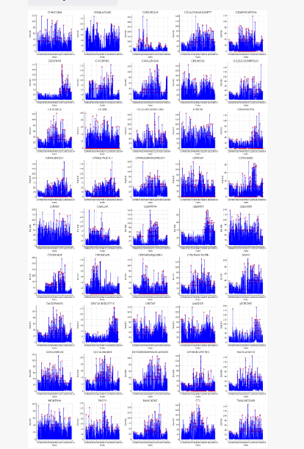
OUTLIERS - SVM

Slide 10
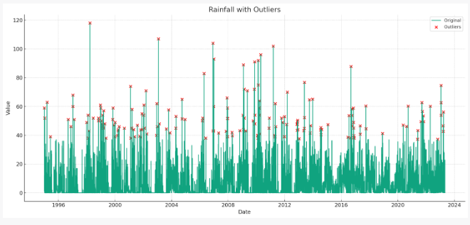
OUTLIERS - Z score method
Here's the plot of the Rainfall data with outliers. The original data is shown in blue, and the outliers (data points that are more than 3 standard deviations away from the mean) are marked in red.
As you can see, these outliers represent days where the rainfall was significantly higher than average.
Let's perform a statistical analysis to detect these outliers. We'll use the Z-score method. The Z-score is a measure of how many standard deviations an element is from the mean. A Z-score greater than 3 or less than -3 can be considered an outlier.

Slide 11
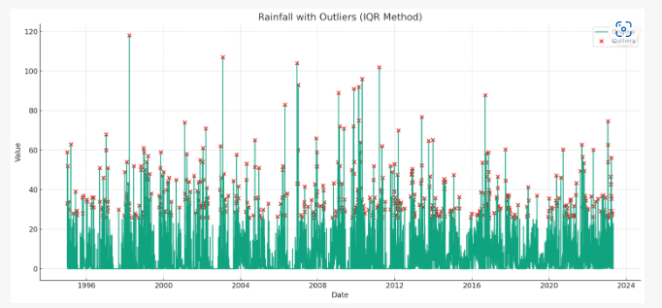
OUTLIERS - IQR method
Here's the plot of the Rainfall data with outliers identified using the Interquartile Range (IQR) method. The original data is shown in blue, and the outliers (data points that fall outside the range defined by the IQR) are marked in red.
As you can see, these outliers represent days where the rainfall was significantly higher or lower than the typical range.
The IQR method is based on the concept of quartiles in statistics. Quartiles divide a rank-ordered dataset into four equal parts. The values that divide each part are called the first, second, and third quartiles. The IQR is the range between the first quartile (25 percentile) and the third quartile (75 percentile). In the IQR method, a data point is considered an outlier if it is below Q1−1.5×IQR or above Q3+1.5×IQR.

Slide 12
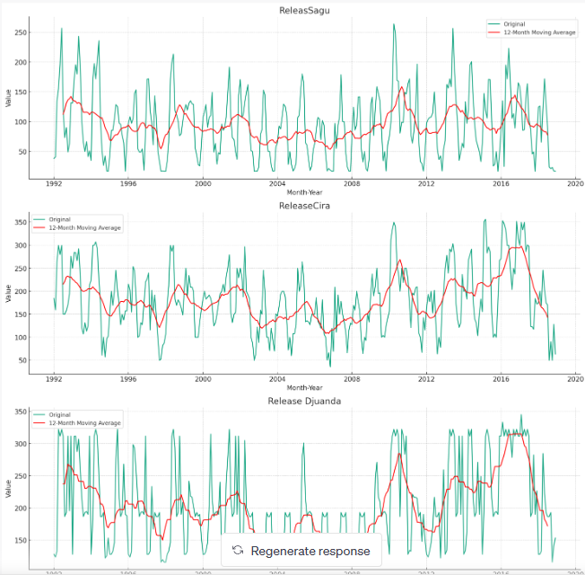
OUTLIERS - Trend Analysis
The red lines in the plots represent the 12-month centered moving averages for each series. You can see how these lines capture the overall trend of the series, smoothing out the short-term fluctuations.

Slide 13
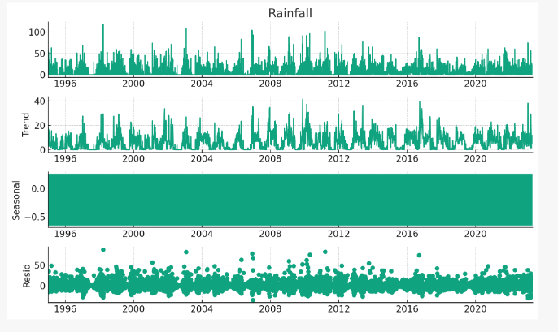
OUTLIERS - Time series decomposition
Time series decomposition involves thinking of a series as a combination of level, trend, seasonality, and noise components. These components are defined as follows:
Level: The average value in the series.
Trend: The increasing or decreasing value in the series.
Seasonality: The repeating short-term cycle in the series.
Noise: The random variation in the series.
Decomposition provides a structured way of thinking about a time series forecasting problem, and perhaps new ways to reframe the prediction problem.

Slide 14
OUTLIERS - Transforming DATA
When time series data is highly skewed, standard outlier detection methods like the Z-score or IQR method may not perform well, because these methods are based on the assumption that the data is normally distributed or uniformly distributed. Skewness can significantly distort these assumptions.
One approach in such scenarios is to transform the data in a way that makes it more symmetric, like a normal or uniform distribution.
A common transformation for right-skewed data is the logarithmic transformation, which can pull in high values and spread out low ones.
Similarly, for left-skewed data, you might apply an exponential transformation.

Slide 15
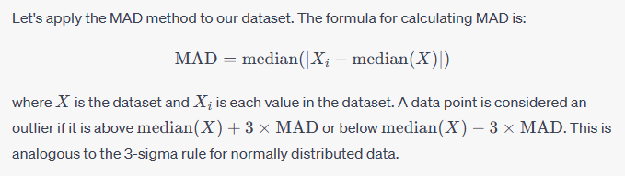
OUTLIERS - MAD
Another approach is to use non-parametric methods for outlier detection, which do not assume any specific distribution of the data.
One such method is the Median Absolute Deviation (MAD) method. The MAD is a measure of variability that, unlike the standard deviation and variance, is not sensitive to the values far from the mean, making it more robust to outliers.
This approach is useful when dealing with skewed data because it does not assume a specific distribution of the data. Instead, it considers points that are far from the median, in terms of the typical deviation (MAD), to be outliers. This makes it more robust to skewed data compared to methods that are based on the mean and standard deviation, such as the Z-score method.

Slide 16
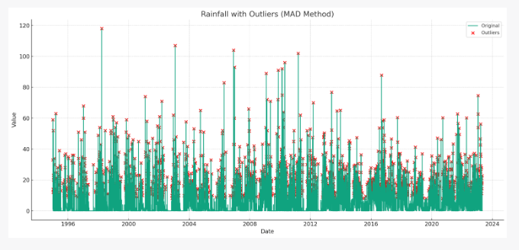
OUTLIERS - MAD
The table above shows the data points in the 'Rainfall' column that are considered as outliers based on the Median Absolute Deviation (MAD) method. These are the data points that fall below the lower threshold (median - 3MAD) or above the upper threshold (median + 3MAD).
In total, there are 3104 outliers in the data according to the MAD method. These are days where the rainfall was significantly higher or lower than the typical range (defined by the MAD).
Outliers are detected in June 1992, May 1993, June 1994, March 2010, April 2010, May 2010, June 2013, Feb 2015, Mar 2015, Feb 2016, Mar 2916, Apr 2016, Jun 2016, Nov 2016, Feb 2017, Mar 2017, April 2017

Slide 17
OUTLIERS - other methods
Time Series Decomposition: This method breaks down a time series into its trend, seasonality, and residual components. Outliers can often be detected in the residuals after the trend and seasonal components have been removed. This can be done using methods like STL (Seasonal and Trend decomposition using Loess).
AutoRegressive Integrated Moving Average (ARIMA): This is a forecasting technique that can be used to model time series data. The residuals from this model can be examined to identify outliers. This method is particularly useful for time series data with a trend and/or seasonal component.
Machine Learning Models: More advanced machine learning methods can be used to model the time series data and detect outliers. For example, an LSTM (Long Short-Term Memory) neural network can be trained to forecast the time series, and outliers can be identified as points where the actual value deviates significantly from the predicted value. This approach can handle complex patterns and dependencies in the data.

Slide 18
OUTLIERS - other methods
Change Point Detection: This is a method that detects points where the statistical properties of the time series data change. This could be a change in mean, variance, or distribution of the data. Outliers would be identified as points that are associated with a change.
Bollinger Bands: This is a method used in finance which could be applied to any time series data. It involves creating an upper and lower band around the moving average of a series. Any data point that falls outside these bands could be considered an outlier.
Remember that each method has its strengths and weaknesses and may be more or less suitable depending on the characteristics of your specific time series data (e.g., whether it has a trend, seasonal component, etc.). It's also important to remember that not all outliers are bad or should be removed - some outliers may carry important information about the process generating the data.

Slide 19
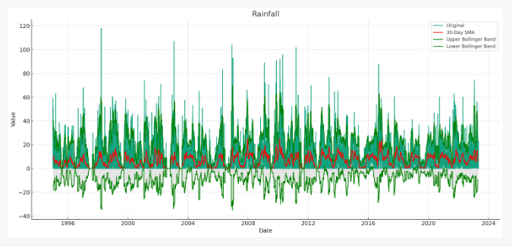
OUTLIERS - BOLLINGER BANDS
Sure, let's apply Bollinger Bands to the data. Bollinger Bands consist of a simple moving average (SMA), and two standard deviation lines that are a certain distance (usually 2 standard deviations, which captures about 95% of the variation if the data is normally distributed) away from the SMA. Points that fall outside the bands are considered potential outliers.
Calculate the moving average (usually a 20-period SMA is used, but we will use a 12-month SAM to account for potential yearly seasonality)
Calculate the standard deviation
Create two lines , one that is SMA + 2 * SD (Upper Bollinger Band) and one that is ‘SMA – 2 *SD’ (Lower Bollinger Band)
Here's the plot of the Rainfall data with Bollinger Bands. The original data is shown in blue, the 30-day Simple Moving Average (SMA) is in red, and the Upper and Lower Bollinger Bands are in green. The area between the Bollinger Bands is shaded in gray.
Points that lie above the Upper Bollinger Band or below the Lower Bollinger Band are considered potential outliers as they deviate significantly from the 30-day SMA.

Slide 20
OUTLIERS - change point detection
Change point detection, also known as change detection, is a technique used to identify the point or points in a dataset where the properties of the data change. This can be useful in a variety of contexts, such as detecting anomalies in time-series data, or identifying the point in time where a change in behavior occurred.
Cusum Test: The cumulative sum (CUSUM) test is a sequential analysis technique typically used for monitoring change detection.
t: Likelihood Ratios: This is a statistical method that compares the likelihood of the data under two different models: one with a change point and one without.
Bayesian Change Point Analysis: This is a probabilistic method that uses Bayesian inference to identify change points.
Change Point Analysis with PELT (Pruned Exact Linear Time): The PELT method is a dynamic programming algorithm that finds the optimal set of change points which minimize a cost function (typically a penalized likelihood) in computational time linear in the number of data points.

Slide 21
OUTLIERS - PCA
Principal Component Analysis (PCA) is a technique for dimensionality reduction, which transforms a set of possibly correlated variables into a smaller set of uncorrelated variables, called principal components.
While PCA is not directly used for outlier detection, it can be utilized in the process. The idea is to transform the original variables to a new set of variables (the principal components), which are uncorrelated, and then utilize these components to identify outliers. In essence, you are projecting your data into a lower-dimensional space which may make outliers more apparent.
However, it's important to note that PCA assumes that the principal components with smaller variances are "noise" and the ones with larger variances are signal. This assumption can sometimes be violated in the presence of outliers, since outliers can inflate the variance. Thus, it can potentially lead to misleading results if not used carefully.
Given that our data is a univariate time series (i.e., we only have one variable, the daily rainfall), PCA might not be applicable here. PCA is generally more useful when dealing with multivariate data.
But if you have multivariate time series data, you could use PCA to reduce the dimensionality, and then use another method (like a statistical test, distance-based method, or machine learning model) to identify outliers in the lower-dimensional space.
For the current dataset, methods like moving average, Isolation Forest, and One-Class SVM are more applicable for outlier detection.

Slide 22
OUTLIERS - LIKELIHOOD RATIOS
Likelihood ratios are a statistical method used for change point detection. The general idea is to compare the likelihood of the data under two different models: one with a change point and one without.
For a given set of data and a given point in the data, we can calculate the likelihood of the data under the assumption that there is a change point at that point. This is done by fitting a model to the data before the change point and a separate model to the data after the change point, and then calculating the likelihood of the data given these models.
We can also calculate the likelihood of the data under the assumption that there is no change point, by fitting a single model to all of the data.
We then take the ratio of these two likelihoods. If the ratio is significantly greater than 1, this suggests that the data are more likely under the model with a change point, indicating that a change point is present.

Slide 23
OUTLIERS - LIKELIHOOD RATIOS
Books
Outlier Analysis by Charu C. Aggarwal: This is a comprehensive text on outlier analysis, discussing various techniques for outlier detection including for time series data.
Time Series Analysis and Its Applications: With R Examples by Robert H. Shumway and David S. Stoffer: This book covers a broad range of topics in time series analysis, including outlier detection.
Research Papers
Anomaly detection in time series of graphs using ARMA processes by A. Siffer, P. Fouque, A. Termier, and C. Largouet.
Outlier Detection in Time Series Data by Z. He and X. Xu.
Online Tutorials and Blogs
Time Series Anomaly Detection Algorithms on Towards Data Science: This blog post discusses several methods for detecting anomalies in time series data.
Anomaly Detection in Time Series Data with Keras by Venelin Valkov: This tutorial uses a deep learning approach for anomaly detection in time series data.
Documentation
Scikit-learn's page on Outlier Detection: This page discusses several methods for outlier detection, including the One-Class SVM and Isolation Forest methods that we used here.

